Slide 1
Boosting Algoritham-Regression
ADA Boost:
AdaBoost is a powerful machine learning algorithm that can significantly enhance the performance of weak classifiers
One of the significant advantages of AdaBoost is its simplicity and ease of implementation
The algorithm can be applied to various types of base learners, such as decision trees, neural networks, and support vector machines
In addition to the training time, the prediction phase can also be slower, as the final model combines the outputs of all weak learners

Slide 2
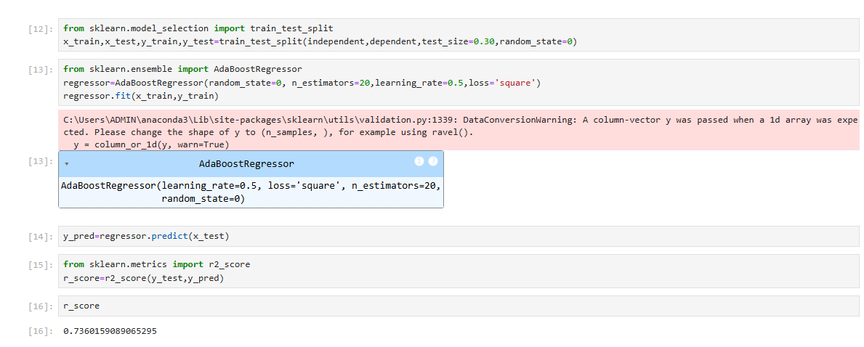
Model Created for Ada Boost :

Slide 3
LG Boosting Regression:
Gradient boosting can be used for regression and classification problems. Here, we will train a model to tackle a diabetes regression task.
It can handle large datasets with lower memory usage and supports distributed learning
Best practices for using Gradient Boosting include Hyperparameter tuning: Hyperparameter tuning is crucial for achieving optimal performance.

Slide 4
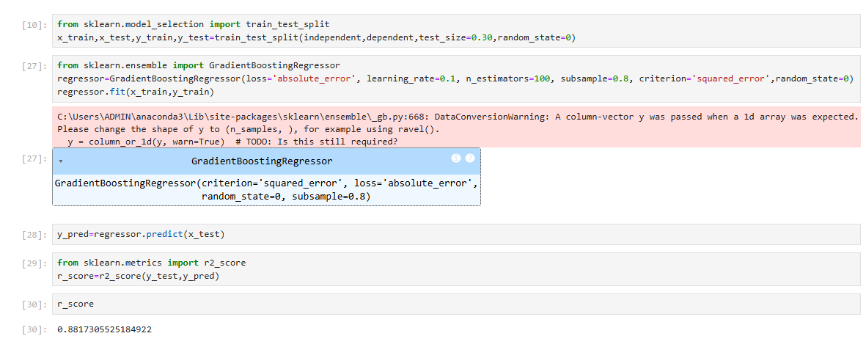
Model Created for LG Boost :

Slide 5
XG Boosting Regression:
XG Boost (eXtreme Gradient Boosting) is an efficient and scalable implementation of gradient boosting, designed for speed and performance for regression tasks,
It minimizes a specified loss function by optimizing an ensemble of decision trees.
XG Boost uses gradient descent to optimize the model by reducing the errors of weak learners
Advantages of XG Boost Regression
High Accuracy: Outperforms traditional regression techniques in most structured data problems.
Speed: Optimized for faster computation, especially on large datasets.
Scalability: Works efficiently with both small and large-scale datasets.

Slide 6
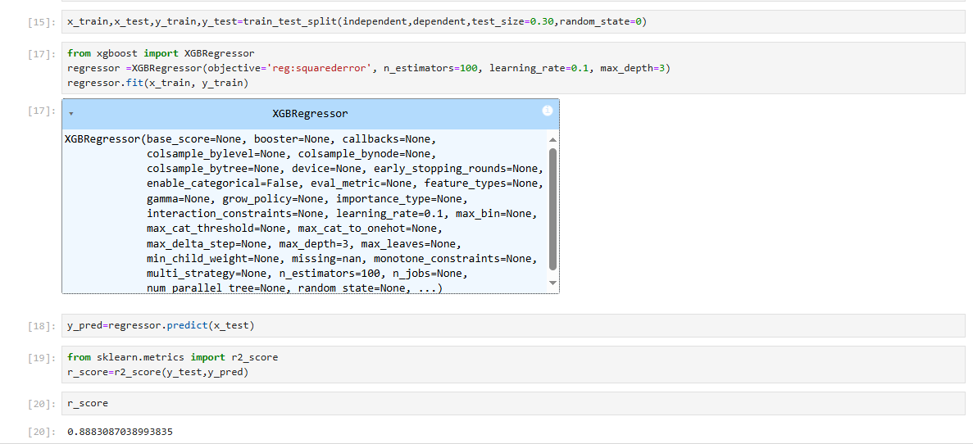
Model Created for XG Boost :

